Slide 1

AN APPROACH TO IMPLEMENT CRYPTOGRAPHY IN QUANTUM NEURAL NETWORKS AND DNN-BASED KEY HIDING
Kritika Chugh
SUID: 882046659
&
Hemanta Kumar Pattnaik
SUID: 770755090

Slide 2
A problem broken in 2 parts
Steganography – Concealing Images in plain sight
How quantum neural network helps?

Slide 3
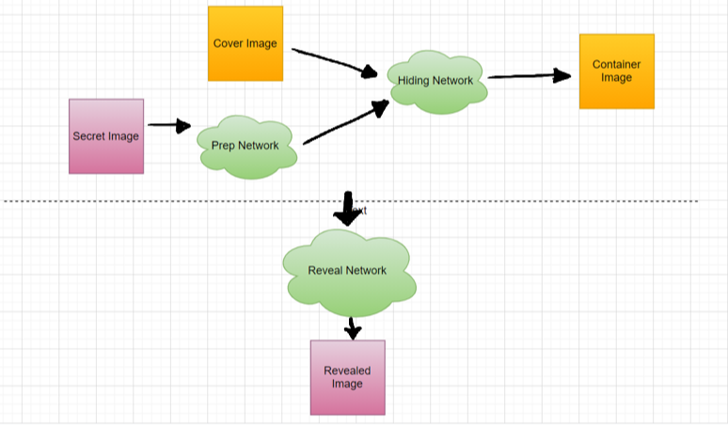
The first half of the solution - Steganography
What are we doing in this technique?
  We are attempting to utilize any random image and using an image of same size we want to hide the bits of the original image and store it in the cover image.

Slide 4
Role of the neural network
In our work the neural network will determine where to place the secret information and how to encode that information in an efficient manner.
The role of the DNN is to act on LSB.
Note : networks are trained once. Not again and again.
Why?

Slide 5
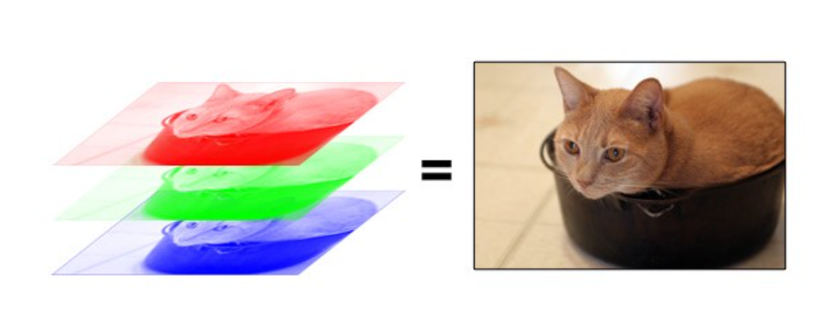
What have we implemented and working on so far?
We have implemented the most significant bit function that utilizes the pixel concept and color models.
References to understand the RGB and hue model for images that we have utilized so far:
https://web.stanford.edu/class/cs101/image-1-introduction.html
https://www.cronj.com/blog/color-space-image-processing/

Slide 6
What’s next?
We mainly are going to venture into implementing the code for the algorithm that utilizes the RGB model of the original and the cover image
The resulting implementation will focus on the encode and decode of the images and results will be shared in the paper.
Novelty will be to implement an extra layer of encryption on the original image and then performing the encoding and decoding with the cover image. We want to understand and demonstrate how well can our resulting algorithm can handle such change?
Last, we want to discuss the quantum neural networks and its future roles in the problem at hand.

